Slide 1
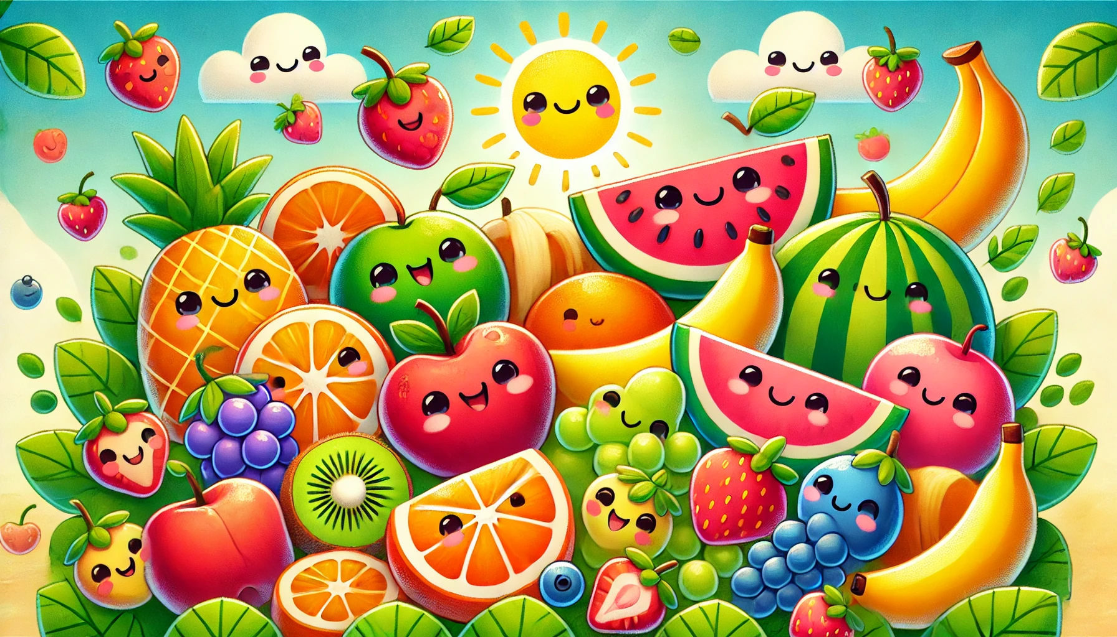
Fruits
Livre de Coloriage

Slide 2


Tracer & Colorer
Fruits
Citron

Slide 3
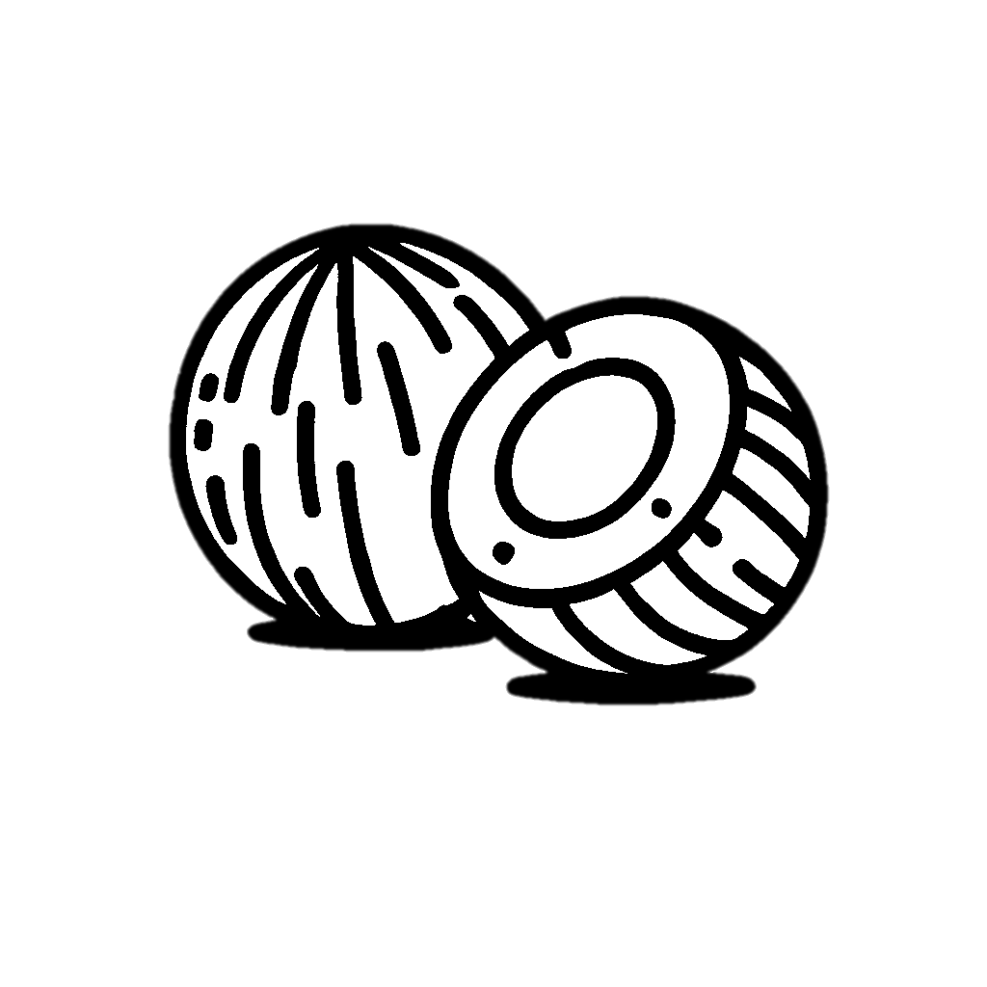
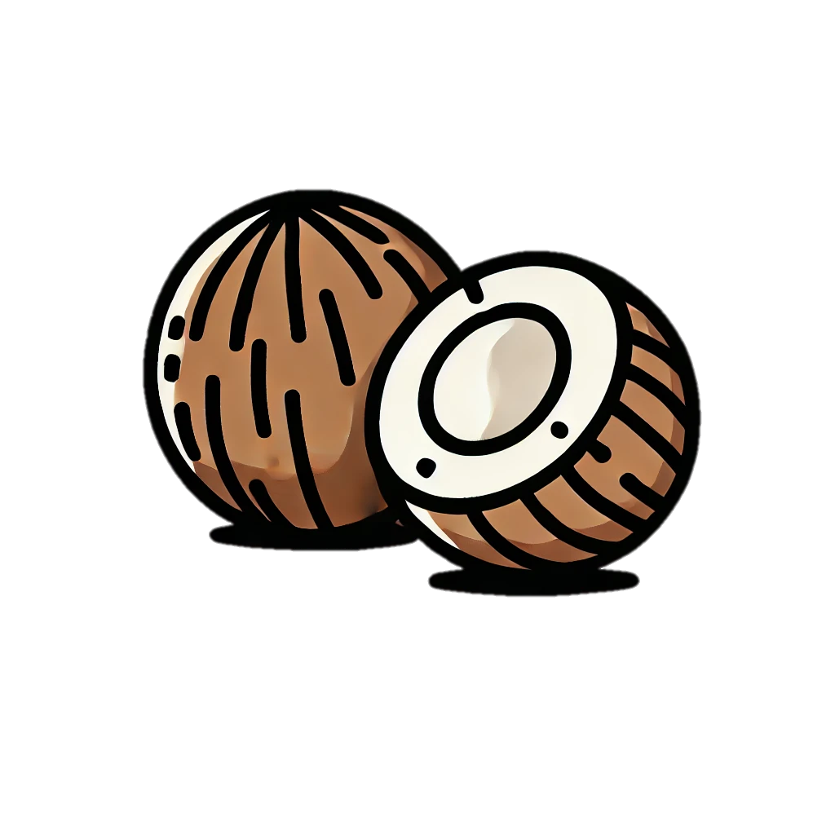
Tracer & Colorer
Fruits
Noix de coco

Slide 4

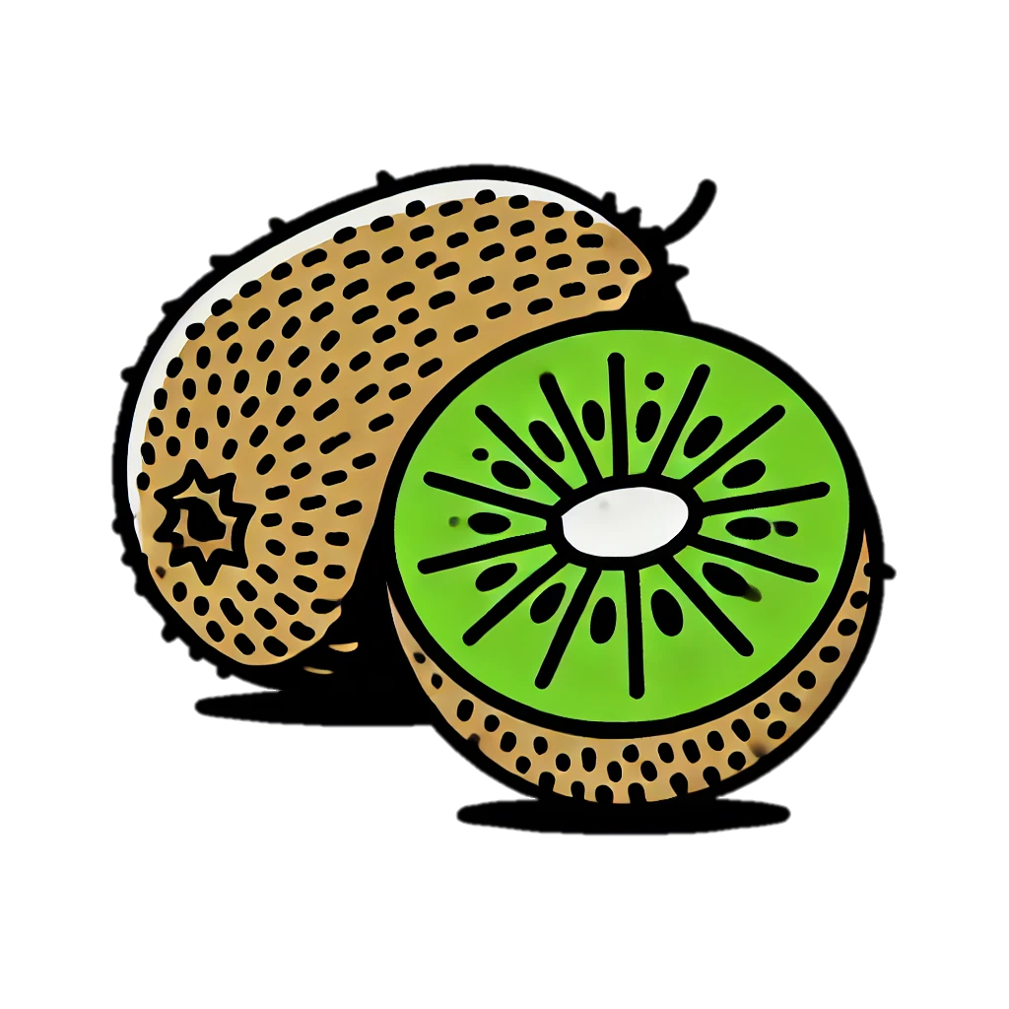
Tracer & Colorer
Fruits
Kiwi

Slide 5


Tracer & Colorer
Fruits
Citron vert

Slide 6
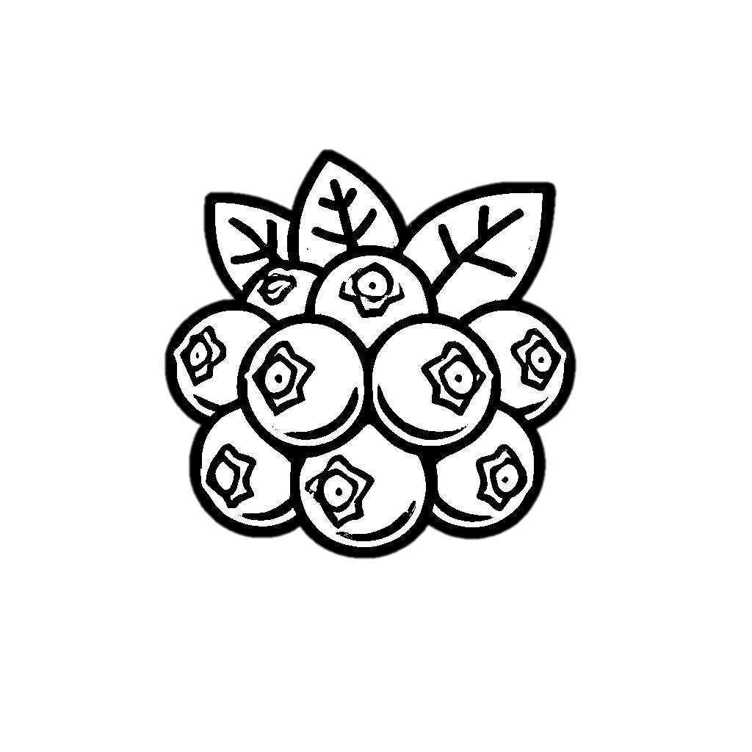
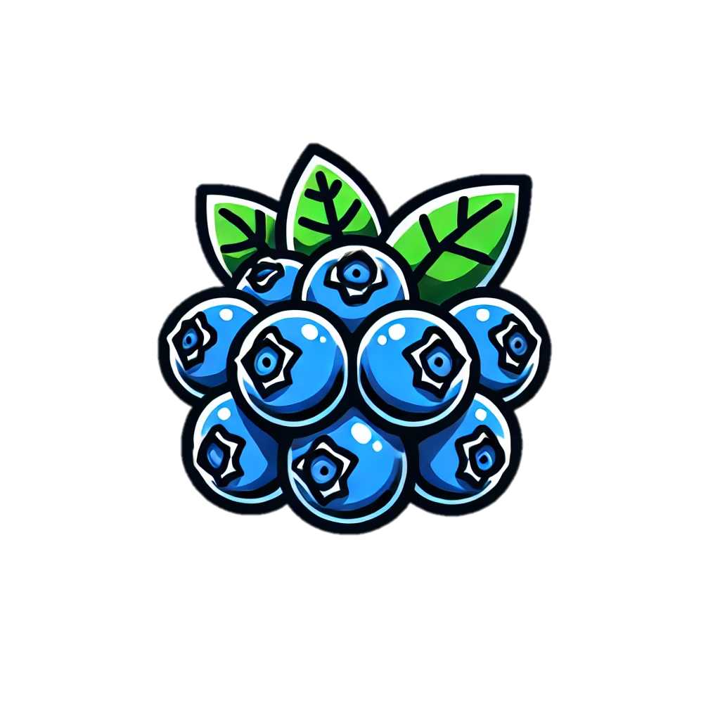
Tracer & Colorer
Fruits
Myrtille

Slide 7


Tracer & Colorer
Fruits
Framboise

Slide 8


Tracer & Colorer
Fruits
Mûre

Slide 9


Tracer & Colorer
Fruits
Fruit de la passion

Slide 10
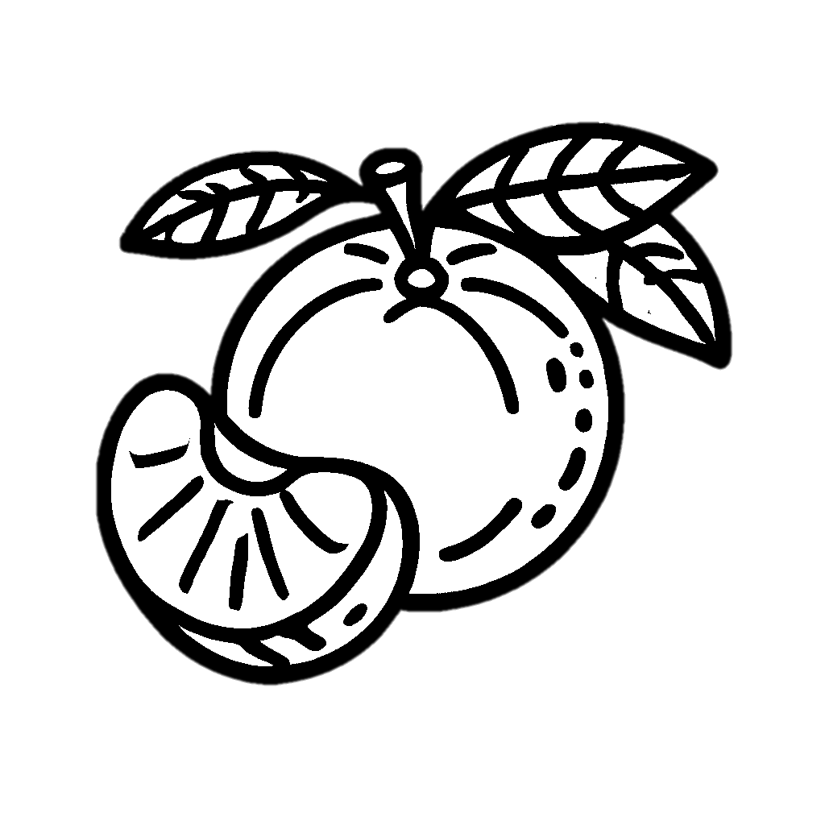

Tracer & Colorer
Fruits
Mandarine

Slide 11


Tracer & Colorer
Fruits
Abricot

Slide 12
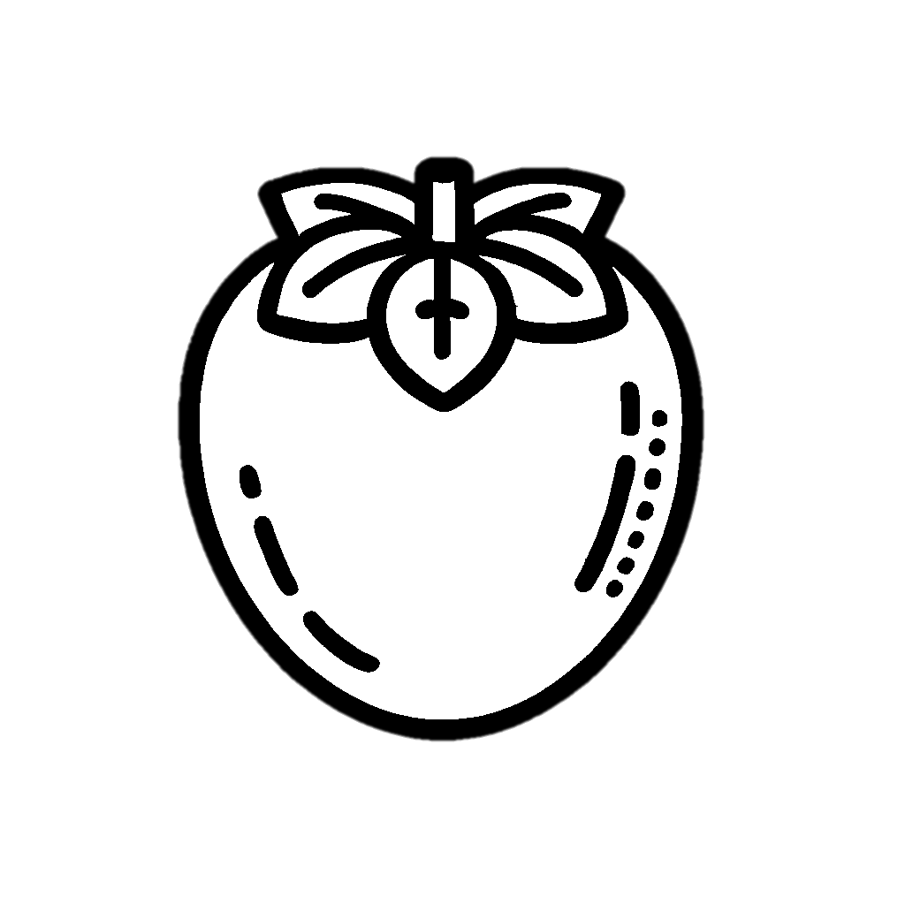

Tracer & Colorer
Fruits
Kaki

Slide 13


Tracer & Colorer
Fruits
Fruit du dragon

Slide 14


Tracer & Colorer
Fruits
Carambole

Slide 15


Tracer & Colorer
Fruits
Litchi

Slide 16

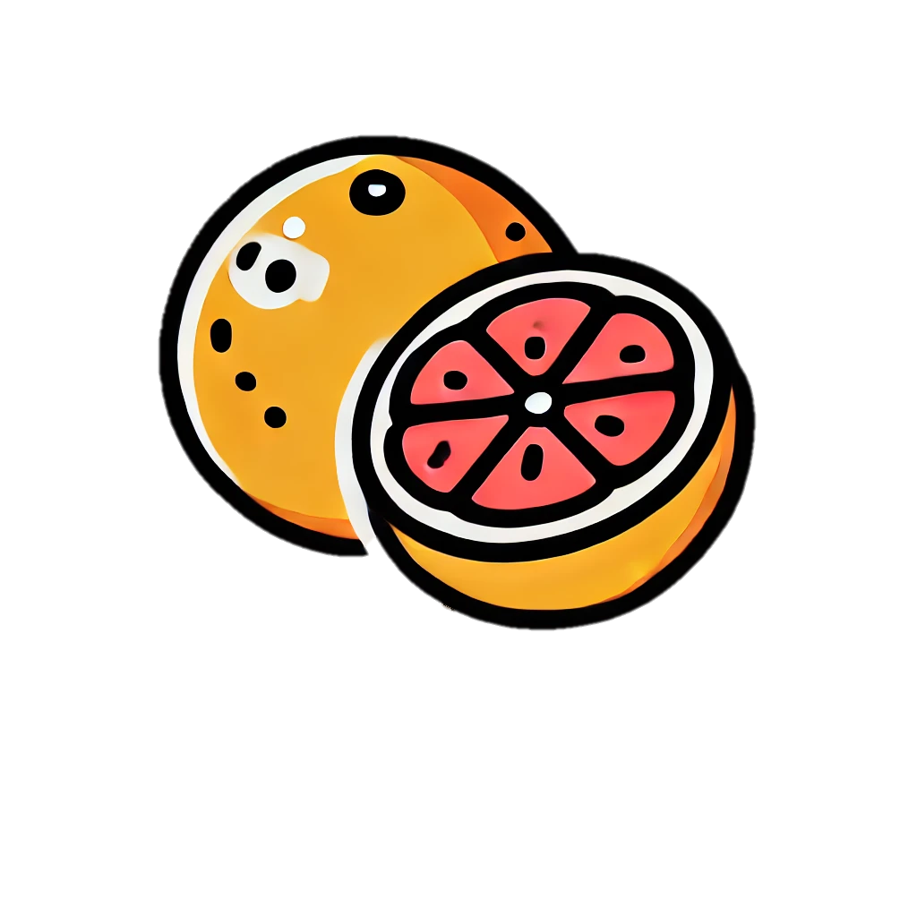
Tracer & Colorer
Fruits
Pamplemousse

Slide 17
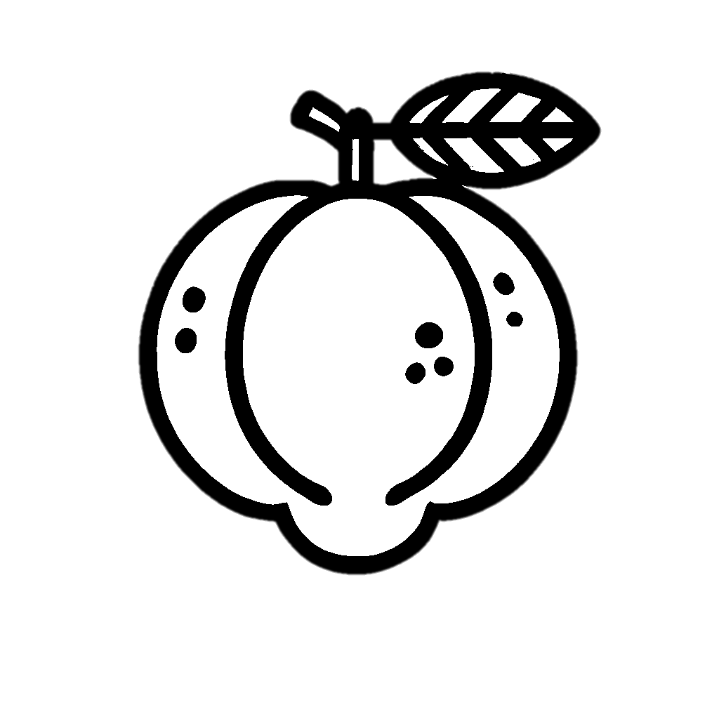
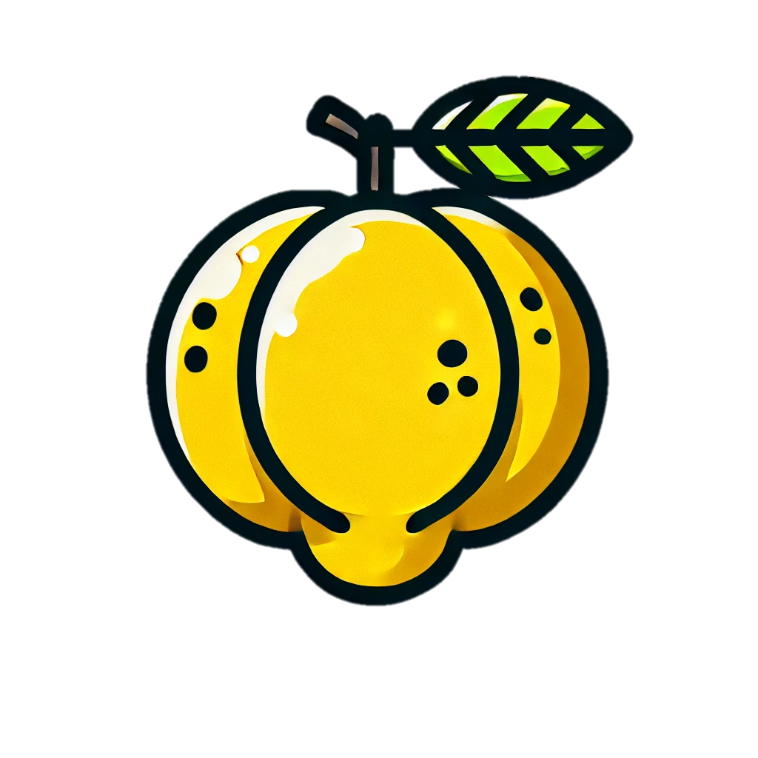
Tracer & Colorer
Fruits
Coing

Slide 18
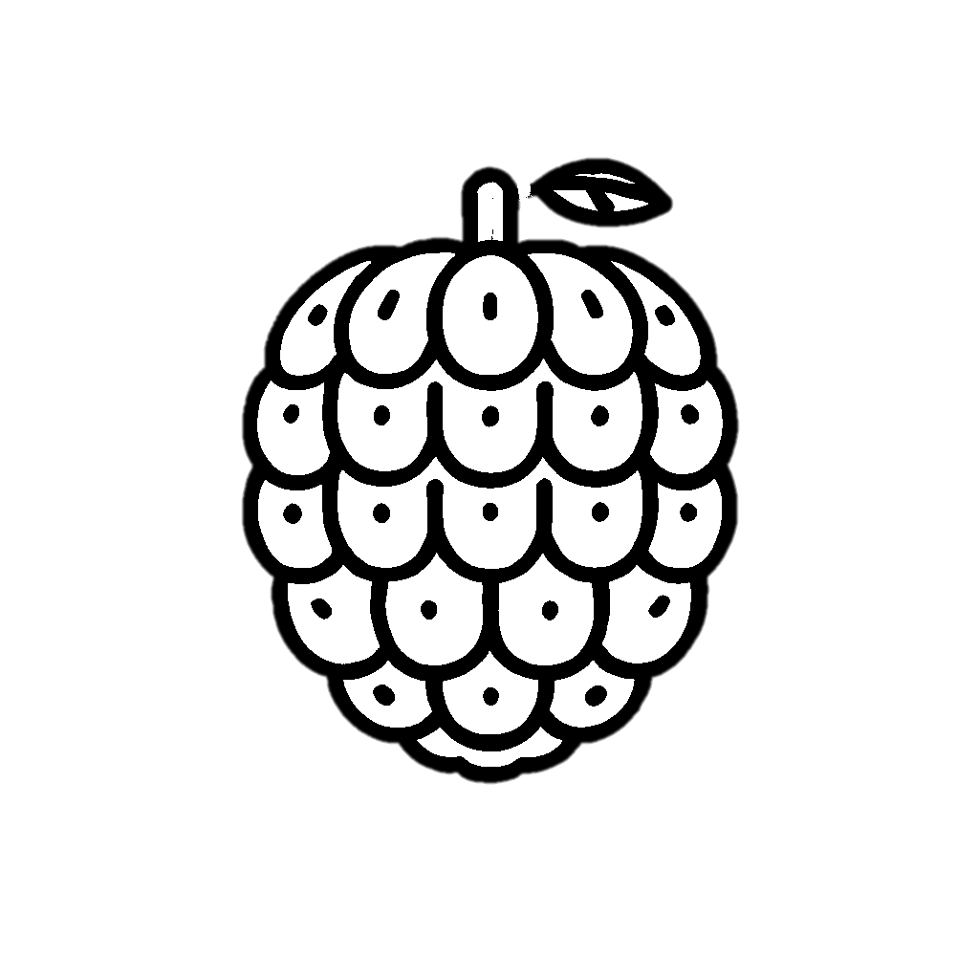
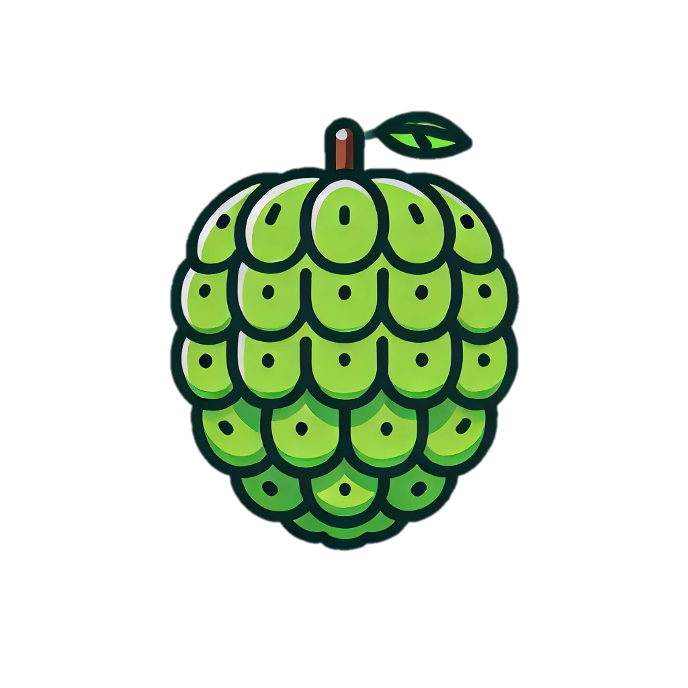
Tracer & Colorer
Fruits
Chérimole

Slide 19
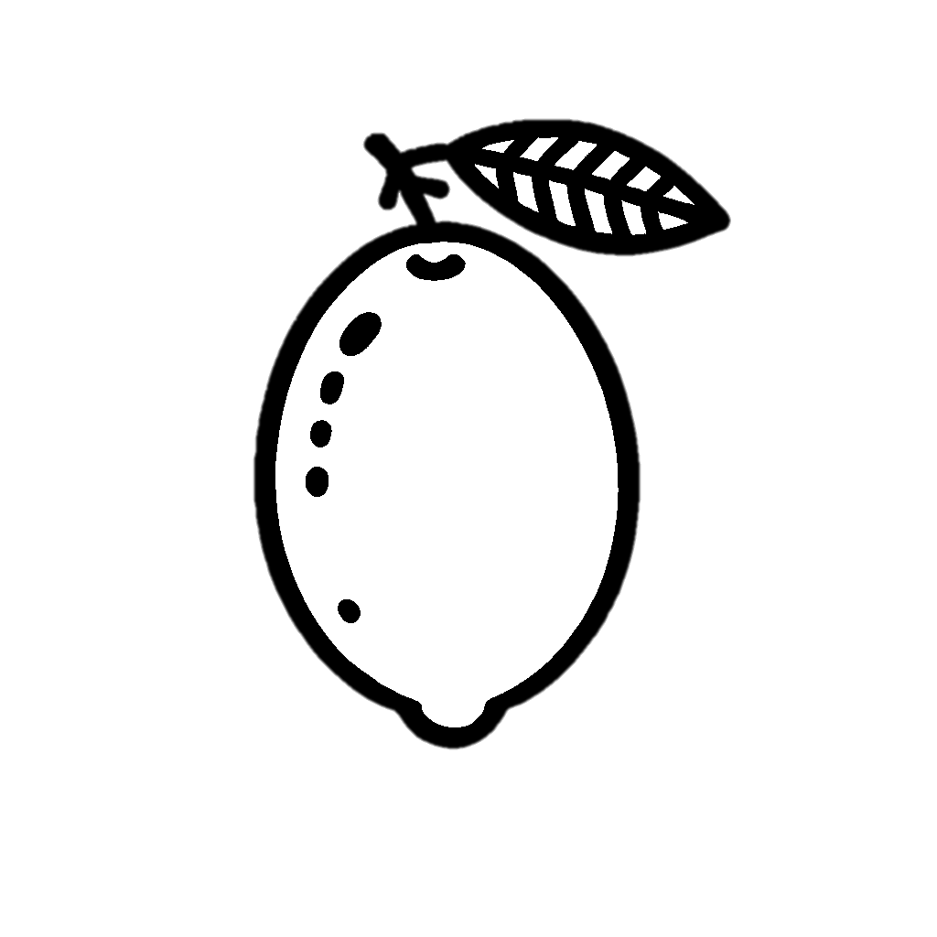

Tracer & Colorer
Fruits
Kumquat

Slide 20


Tracer & Colorer
Fruits
Melon

Slide 21
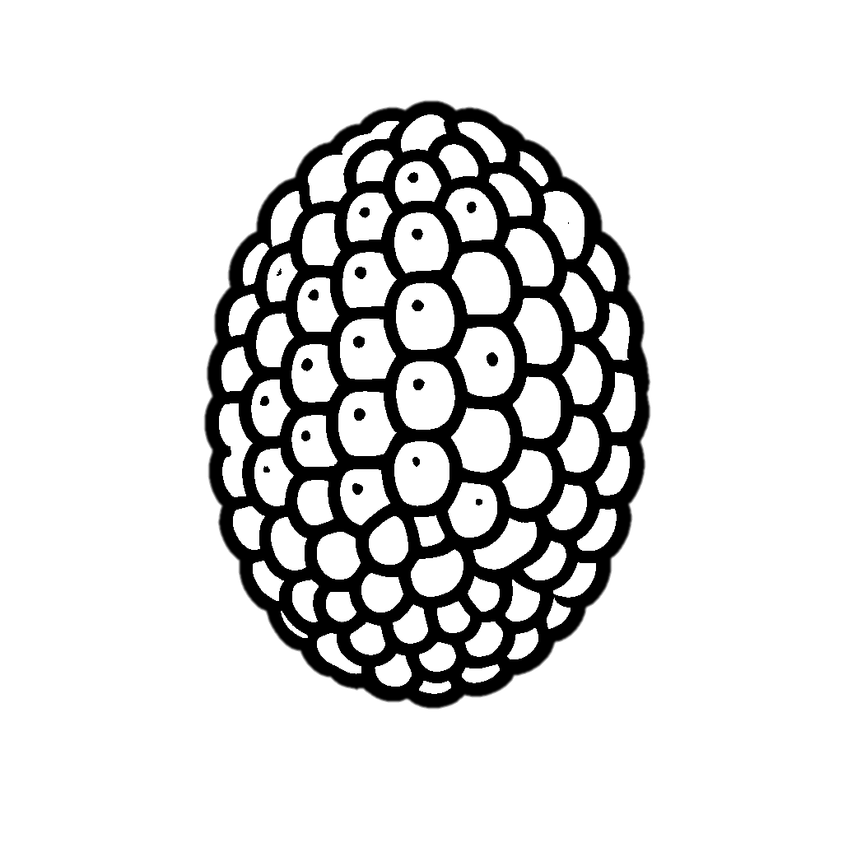
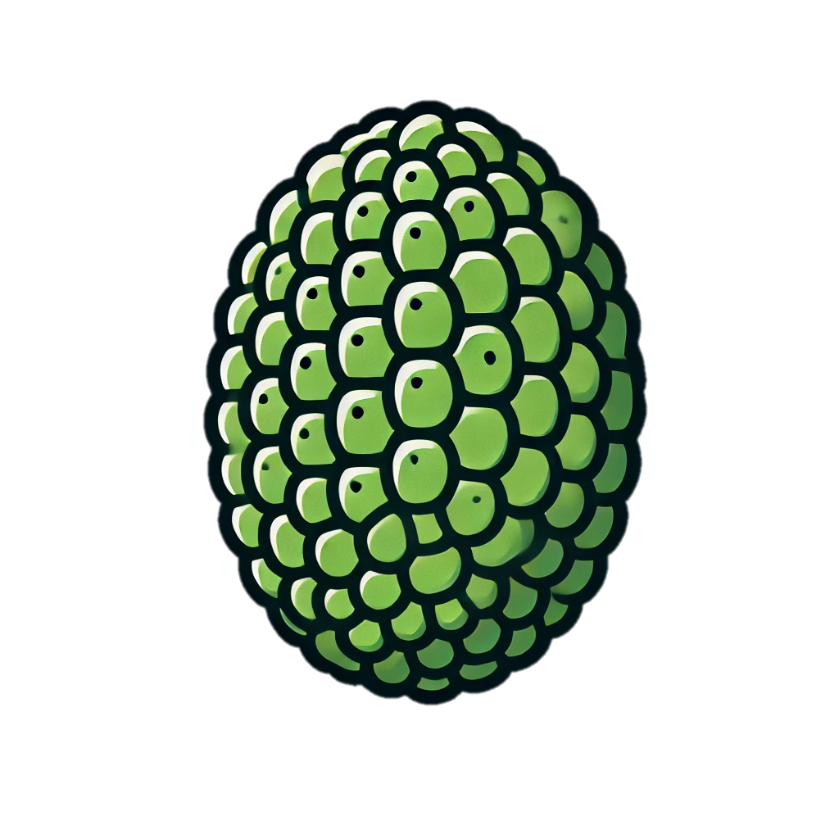
Tracer & Colorer
Fruits
Jacquier

Slide 22


Tracer & Colorer
Fruits
Sapote

Slide 23
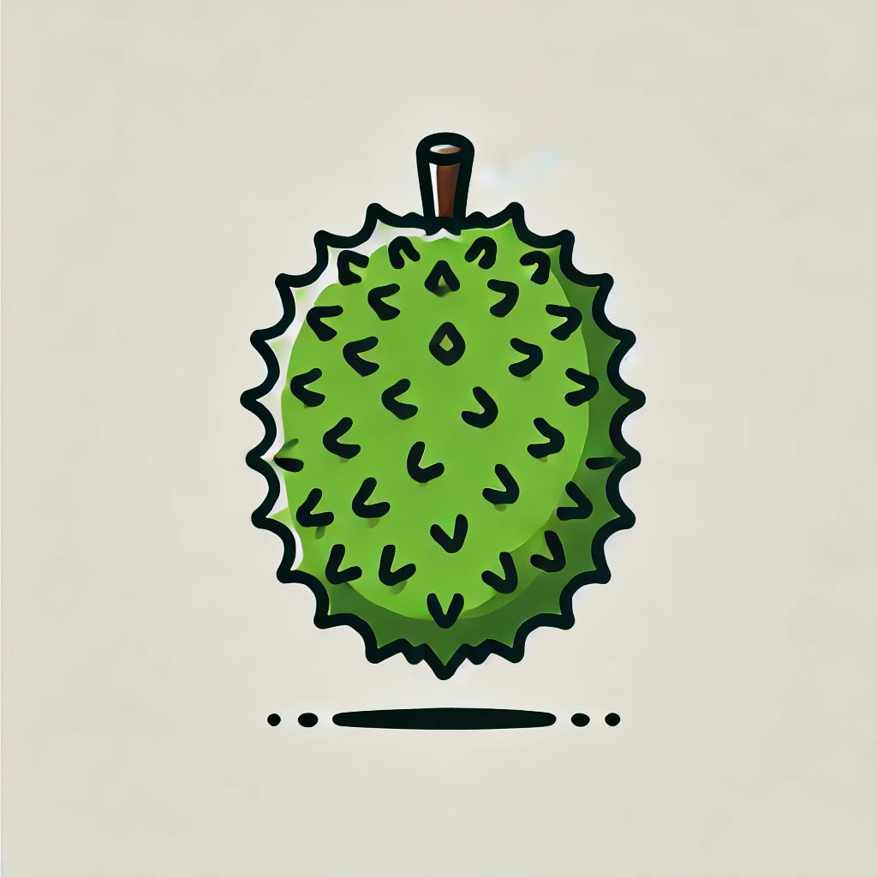


Tracer & Colorer
Fruits
Corossol

Slide 24
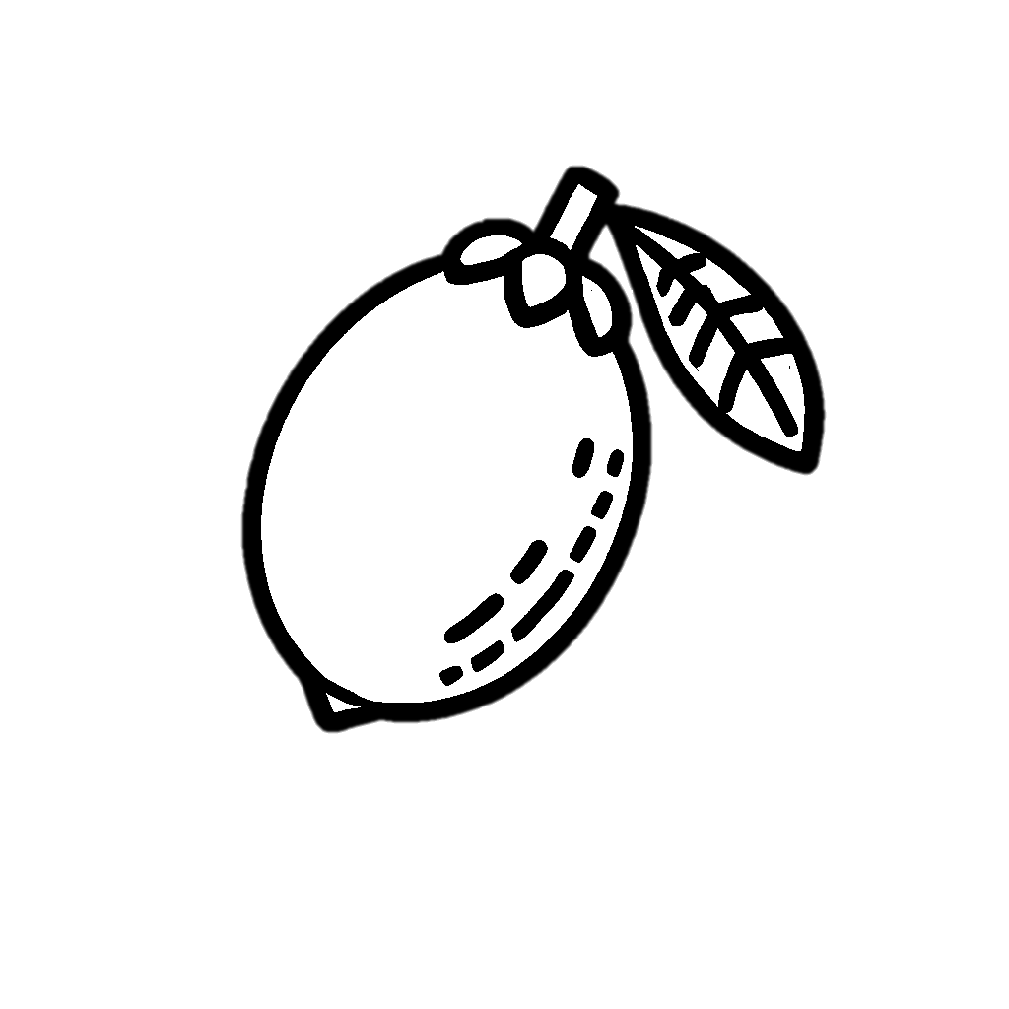
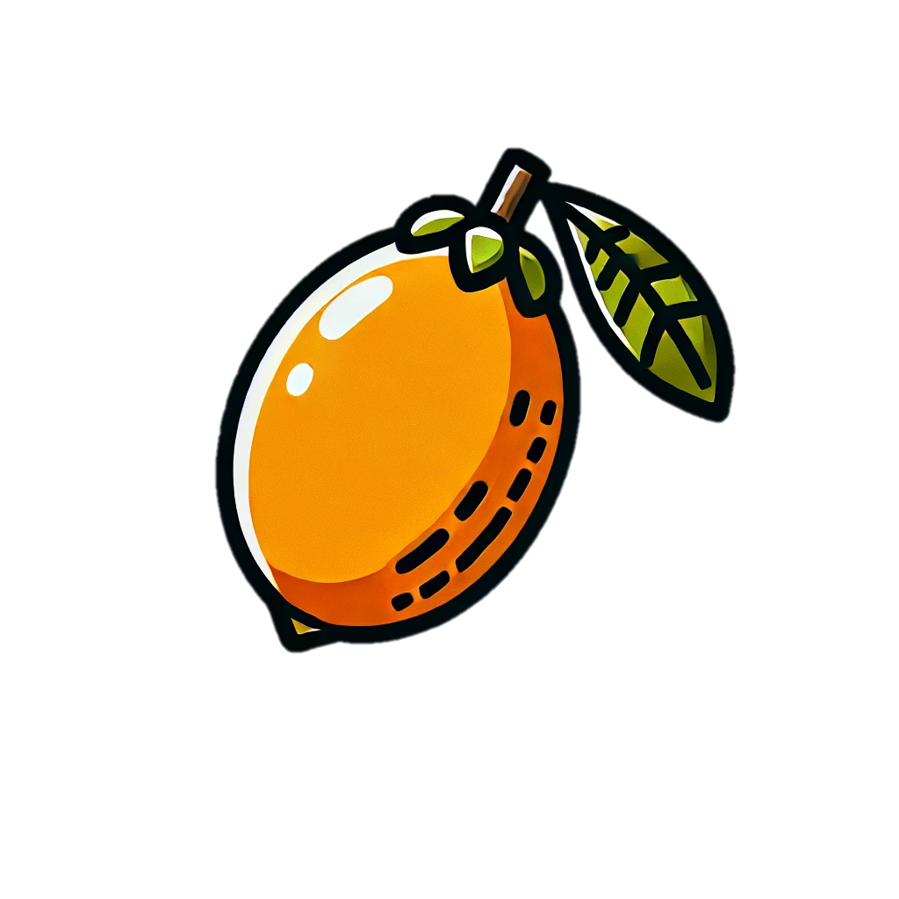
Tracer & Colorer
Fruits
Nèfle

Slide 25
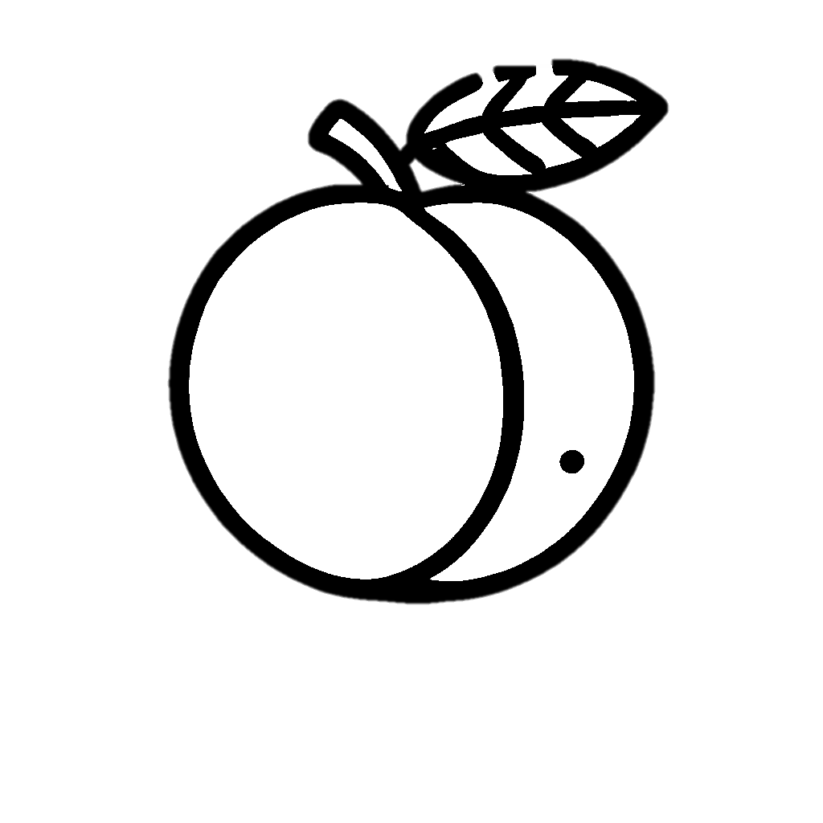
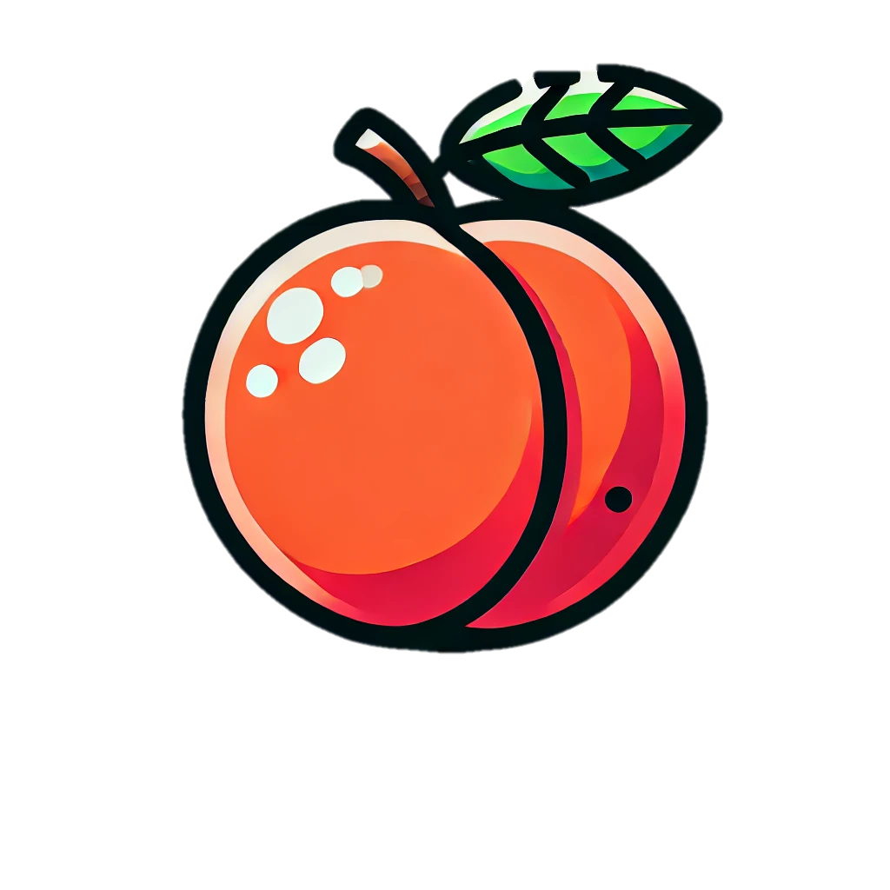
Tracer & Colorer
Fruits
Nectarine

Slide 26


Tracer & Colorer
Fruits
Ramboutan

Slide 27


Tracer & Colorer
Fruits
Anacardier

Slide 28
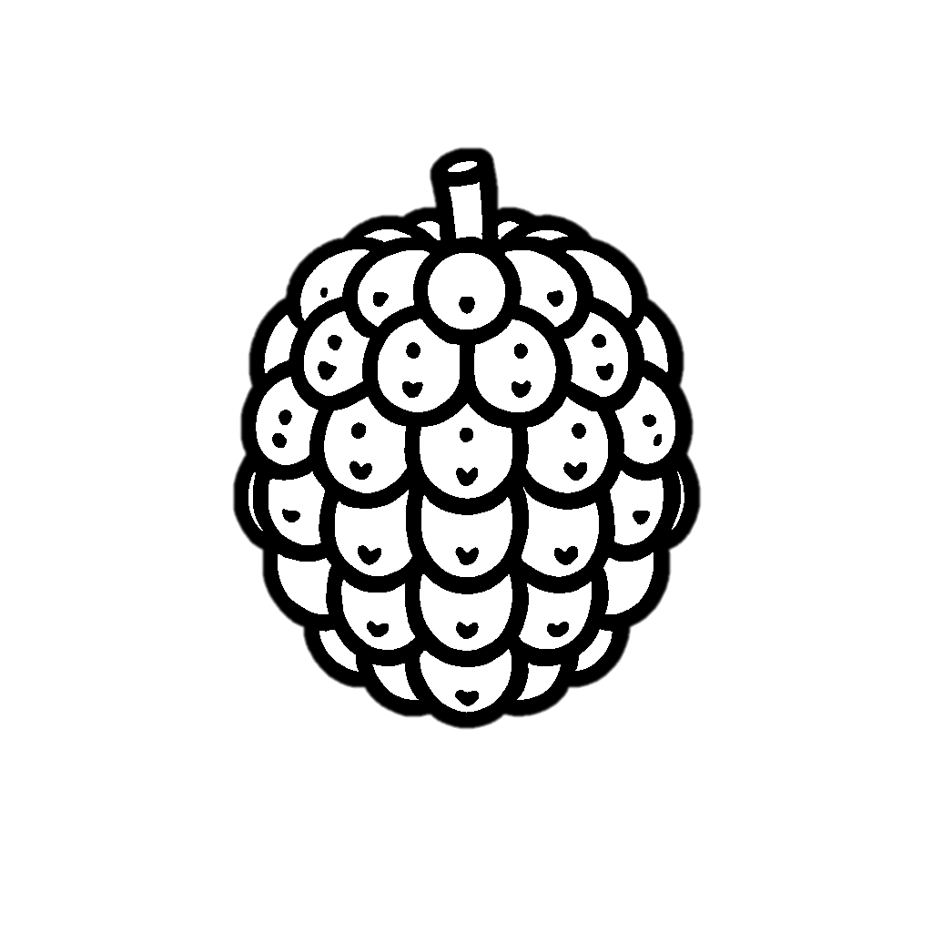
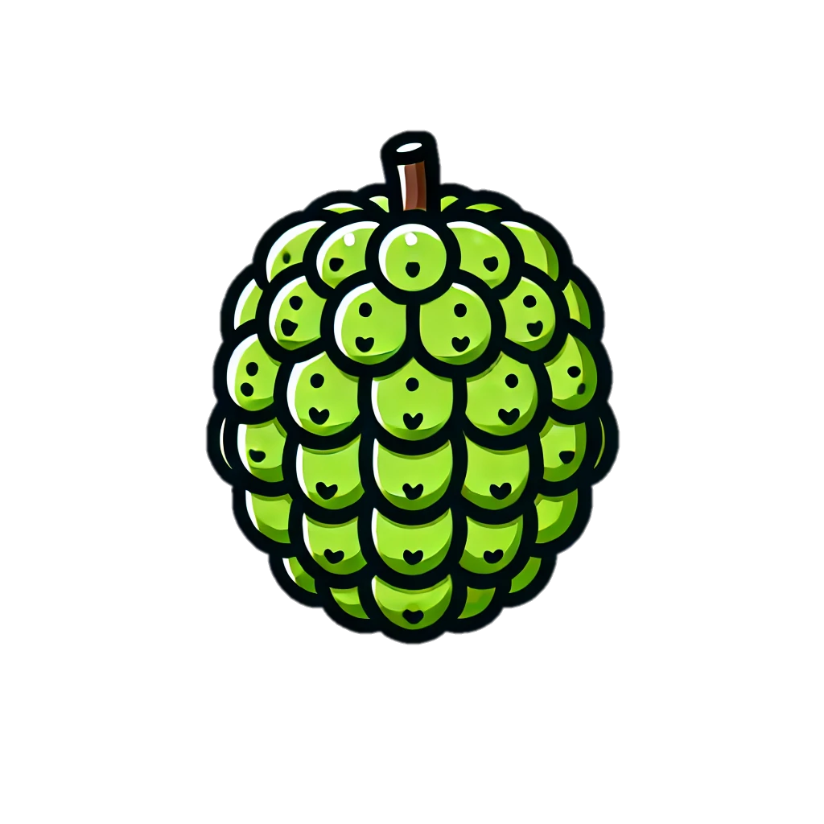
Tracer & Colorer
Fruits
Pomme-cannelle

